Slide 1
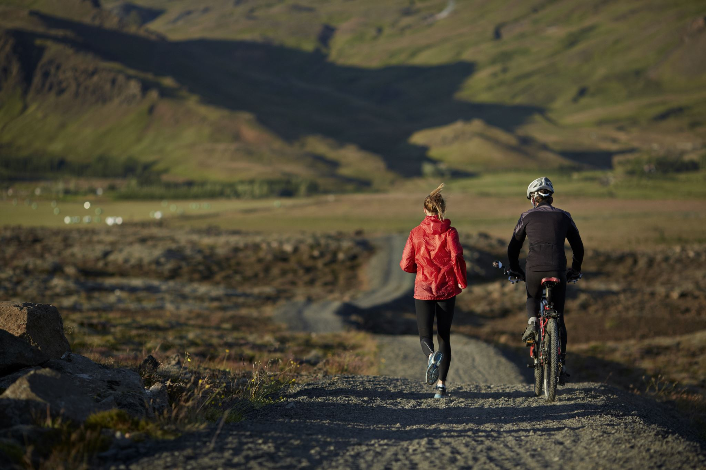

Cyclıstıc
Bike Share Analysis
By
G.Arivazhagan
MBT7

Slide 2
Over View of The Data

Slide 3
Casual Riders (CR)
Members (M)
2,30,692
3,02,266
Avg. Ride Duration (CR)
Avg. Ride Duration (M)
Total Rides
38.12
15.46
5,32,958
Avg. Ride Duration
Busiest Day (CR)
Busiest Day (M)
25.27
Saturday
wednesday
Busiest Time (CR)
Busiest Time (M)
Afternoon
Afternoon

Slide 4
Marketing Strategies

Slide 5
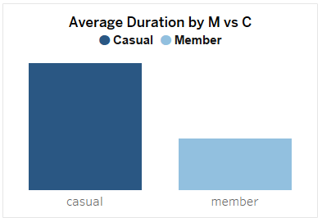
Promote Longer Rental Plans to Casual Riders
Casual riders have a significantly longer ride durations compared to members
We can highlight cost benefits of switching to membership plans for longer rides

Slide 6
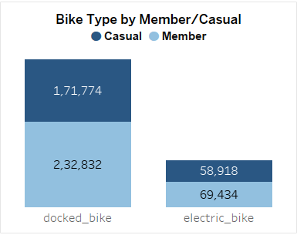
Enhance Member Benefits
Highlight exclusive benefits for members,
such as quicker access to bikes,
reserved bikes at high-demand stations,
rewards for frequent usage.

Slide 7
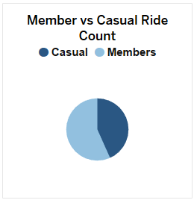
Referral Programs
Casual Riders (CR)
Members (M)
2,30,692
3,02,266
Introduce a referral program where current members can invite friends to join with a discount or bonus, leveraging trust in peer recommendations.

Slide 8
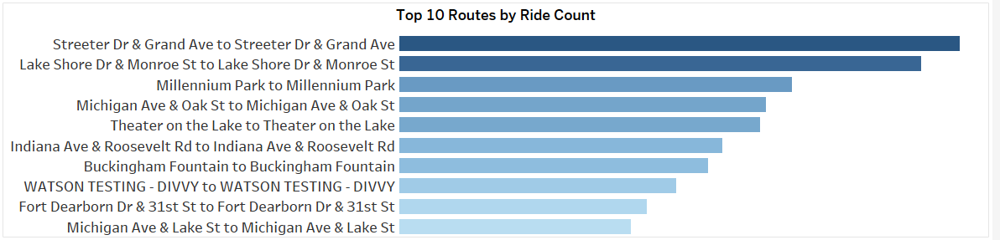
Partnership with Local Businesses
Partner with local businesses near popular stations and Routes to offer discounts or benefits to members, enhancing the value of memberships.

Slide 9
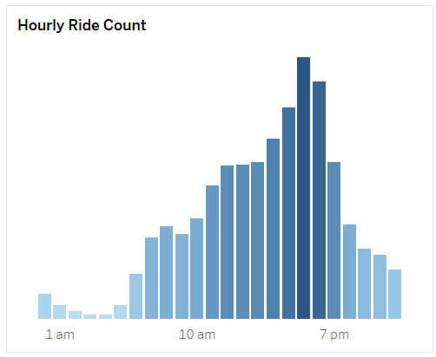
Advanced Booking Options
Provide members with the ability to book bikes in advance during high-demand times or at high-demand stations, targeting frequent users.

Slide 10
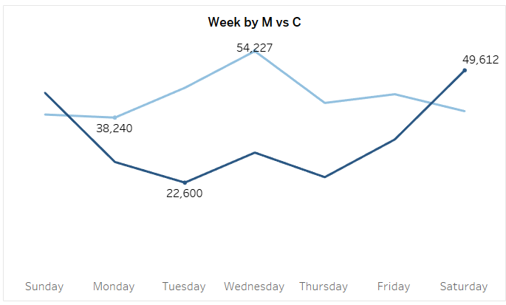
Flexible Membership Plans
Offer a range of flexible membership plans, such as weekend-only or weekday plans,
Designed to convert Riders who mostly ride only prefer weekends or week days.

Slide 11




Social Media Engagement
Use social media to create engaging content showcasing membership benefits, including testimonials and special offers, and provide personalized responses to inquiries.

Slide 12
Marketing point of view

Slide 13
Women Safety
We can install GPS system on bikes that are used by the member where they can track their location and share it with their family.
We can limit the sharing option in between members and casual riders.
This will increase brand trust.

Slide 14
Having multiple marketing point of views
Our marketing should have multiple point of vies like
Women safety
Health and fitness
Ride for fun
Relax your day
Use these point of view we can attract more people who are based on different interest

Slide 15
Marketing Suggestions

Slide 16
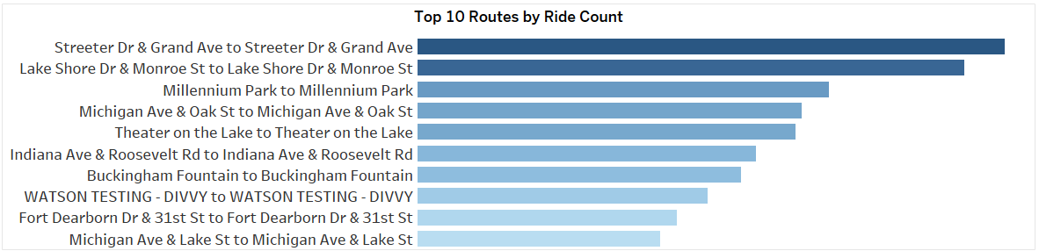
Targeted Campaigns at Popular Stations
Target marketing campaigns at popular stations and routs for casual riders.
Use on-site promotions or interactive sessions.
Explain the benefits of membership plans to casual riders.

Slide 17
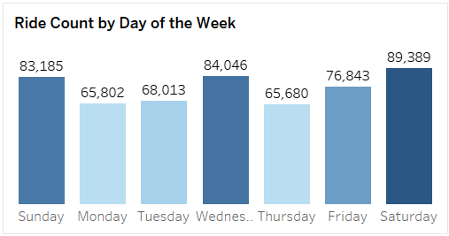
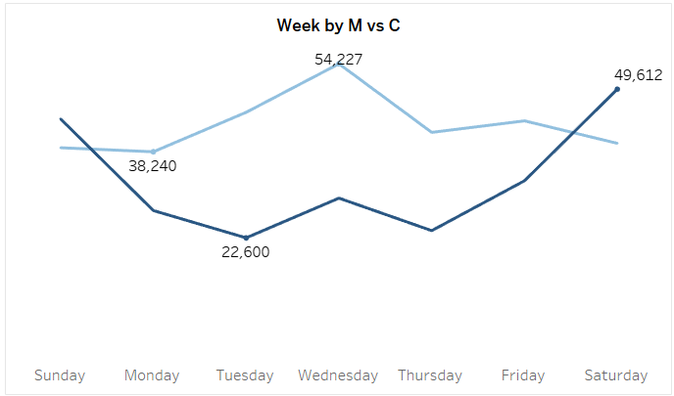
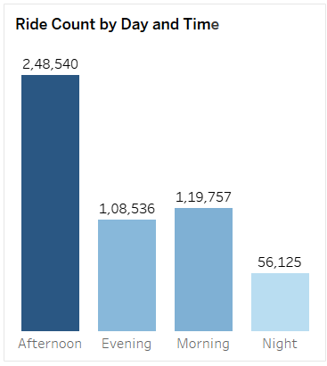
Optimize Time-Based Promotions
To run an effective campaign, we can use time-based promotions:
Our peak time is in the afternoon.
Saturdays are the busiest for our casual riders.
Running a campaign at bike points during these times would be more efficient.

Slide 18
Event-Based Based Promotion
Conduct a rider meet and road show focused on health and fitness.
Distribute pamphlets highlighting membership benefits, including QR codes to our social media pages.
Offer extra discounts to current members and highlight these discounts at the registration stands.

Slide 19
Corporate Memberships
Offer bulk discounts to corporate companies as part of their employee benefits.
Nowadays, gatherings among co-workers are becoming more common.
We can provide corporate memberships to companies with a bulk discount.
Many working professionals are increasingly focused on health and fitness.
Combine gatherings and health activities in one place with our cycling membership plans for corporate companies.

Slide 20
Corporate Memberships
Offer bulk discounts to corporate companies as part of their employee benefits.
Nowadays, gatherings among co-workers are becoming more common.
We can provide corporate memberships to companies with a bulk discount.
Many working professionals are increasingly focused on health and fitness.
Combine gatherings and health activities in one place with our cycling membership plans for corporate companies.

Slide 21
Click the below button to see the Dashboard
Go To Dashboard

Slide 22
By
G.Arivazhagan
MBT7

